Slide 1


for

Slide 2

{Welcome to Progress Virtual Classroom}
Notes:
Progress has a long history of providing tools to make developers happy and successful.
That’s why, when looking new ways to bring value to the customers and thank them for their loyalty, training came to mind.
We understand developers have a choice when it comes to selecting a UI vendor – and we believe that when users decide to partner with Progress, they are getting the very best UI, the very best support and now the very best training at no additional out of pocket expense.
I’m proud to welcome you to the Virtual Classroom, a free training program for Telerik active license holders.

Slide 3
Date | Time | Course
February 28, 2018 | 9am - 1pm EST | Kendo UI & Angular
March 7, 2018 | 9am - 1pm EST | Telerik UI for ASP.NET MVC and ASP.NET Core
March 8, 2018 | 9am - 1pm EST | Kendo UI & React
March 14, 2018 | 9am - 1pm EST | Kendo UI & jQuery
March 22, 2018 | 9am - 1pm EST | Kendo UI & Vue
March 27, 2018 | 9am - 1pm EST | Telerik UI for Xamarin
March 30, 2018 | 9am - 1pm EST | Telerik UI for WPF
April 5, 2018 | 9am - 1pm EST | Telerik Reporting & Telerik Report Server
April 10, 2018 | 9am - 1pm EST | Telerik UI for WinForms
April 12, 2018 | 9am - 1pm EST | Telerik UI for ASP.NET AJAX
April 13, 2018 | 9am - 1pm EST | Telerik UI for UWP
Notes:
With more than 30 hours of technical content created in partnership with New Venture Software, Virtual Classroom is designed to quickly get you onboard and successful with our developer tools whether you’ve been using them for years or are new to the suite. Each session will provide practical knowledge combined with helpful approaches to application development.
The recorded on-demand training videos, slides and demos will be available shortly after the corresponding live training is complete, and all training sessions will be refreshed after each major release. You'll also have access to all the training materials including slides and demos.

Slide 4









Vladimir Milev
Chief Software Architect @
vladi@newventuresoftware.com
github.com/vmilev
vmilev
Notes:
-Read the basic info on the slide
-Great history with Telerik & Progress
-Invite to follow on twitter and on the newventuresoftware blog

Slide 5
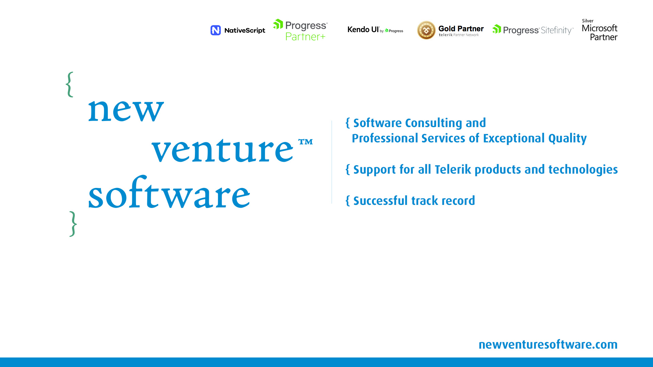
Notes:
A premium consulting and professional services partner for Progress Telerik products and technologies, who’s been instrumental in building the award-winning DevCraft suite.
The exceptional quality of our consulting and professional services stems from a solid background and expertise in Telerik DevCraft. Most of us are ex-Progress Telerik software architects who have led a number of teams building the Telerik DevCraft suite.
We support all progress Telerik products and technologies be it for the web, desktop or mobile and have a successful track record of delivering future-proof software consulting and development solutions.
My teammates and I feel honored and excited to have the opportunity to share with you our experience and passion about the Telerik technologies.

Slide 6

Notes:
Short announcement today before we start
-Read basic info
-It is a developer conference and will be a big one: NEXT + US PUG
-NVS is excited to share that we will be present there as well.
-If you will be attending please stop and say hi
-One of our architects Denis Kyashif will be delivering a talk on Sitefinity so if you are interested check it out!
-If you are still considering – go for it. It will be a great conference with a lot of things to do and learn.

Slide 7

{Agenda}
Why choose Vue.js
Vue Compared to other frameworks
Obtaining Vue.js
Vue library deep dive
Kendo UI for Vue
Live demo
Theme builder and other resources

Slide 8

{Let’s Start}
Sit back and get comfortable

Slide 9
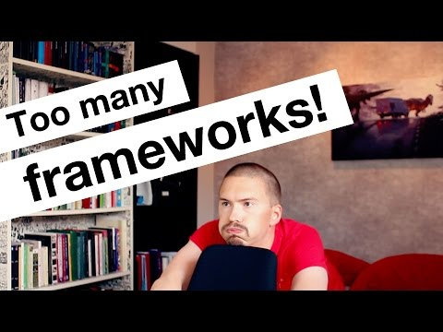
Wait, wait! Aren’t there already….

Slide 10

{Why Vue.js?}
Easy to learn
Easy to develop
Easy to maintain
Fast!
Start fast (size)
Run fast (virtual DOM)
Why Gitlab chose Vue

Slide 11


{Vue compared to Angular}
Angular has TypeScript as language of choice (docs are in TS, using it without TS is a challenge); Vue offers choice
Angular is more opinionated
Angular has a steeper learning curve
Vue is smaller in size (~30KB vs ~130KB)
Angular CLI is has more features
Angular is targeted for large, enterprise-level apps

Slide 12

{Vue compared to React}
Both are unopinionated and offer great performance
Vue ships with a CLI, easier to start a project
React has richer ecosystem
React has a steep learning curve(JSX template syntax, build systems)
React has several rendering modes(ReactNative for iOS and Android, Weex is a similar project for Vue but not production ready yet)

Slide 13



{Tools we will need - 1}
Node.js
https://nodejs.org/en/download/current/
VSCode
https://code.visualstudio.com/
GitHub
https://git-scm.com/downloads
https://github.com/newventuresoftware/kendo-ui-for-vue
Notes:
A big part of today’s training will be coding/demos.
If you are hands of kind of guy and want to follow along with me these are the tools I will be using today.
These are by no means the only tools you can use, just my choice of software.
Also, I think this is a pretty good collection to start learning and working with Vue!

Slide 14
{Tools we will need - 2}
LiveServer
npm install –global live-server
Vetur for VSCode
https://github.com/vuejs/vetur
Devtools for Vue (Chrome extension)
https://chrome.google.com/webstore/detail/vuejs-devtools/nhdogjmejiglipccpnnnanhbledajbpd

Slide 15
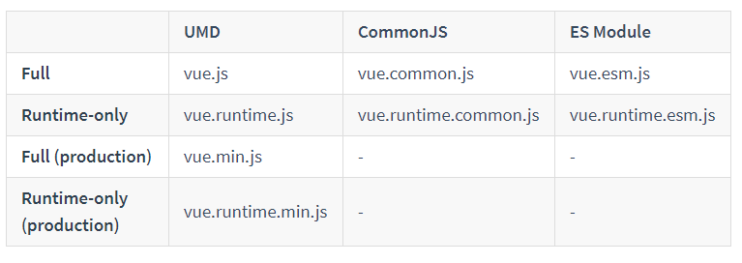
{Getting Vue}
Obtaining Vue
Download @ https://vuejs.org/js/vue.min.js
CDN @ https://unpkg.com/vue
NPM npm install -g vue

Slide 16
{Hello, Vue - Demo}
Let’s see Vue in action for the first time!
Notes:
Including Vue in our HTML
Creating the Vue instance
Mounting the Vue instance to an HTML element
Setting up the data object
Using a declarative template binding to show data
Scope of the Vue
Observability of the data object
Using the Vue Devtools to inspect the Vue

Slide 17

{Short Break}
Please take ~10 minutes to relax and recharge

Slide 18

{Vue.js Deep Dive}
An overview of the most important features of the Vue.js library
Notes:
We are going to take a look at some of the most important features of Vue
This is by no means an exhaustive list
Even the features we look at will not be explored to their fullest extent
There are many additional advanced features for animations, styling and visual appearance

Slide 19
{Template bindings - Demo}
Template bindings are one-way
Can insert content via moustaches {{}} & The v-text directive
Could have one-time bindings with the v-once directive
Raw HTML can be inserted with v-html directive
Bindings support inline javascript expressions
Attribute binding is also supported with v-bind
CSS property and class bindings have extended support

Slide 20
{Input bindings - Demo}
Input elements are bound via the v-model directive
Bindings with v-model are two-way
Vue has support for variety of single-input and select elements
Binding modifiers: .number .lazy .trim

Slide 21
{Handling events}
Events are subscribed with the v-on directive (shorthand @)
Could be handled both inline and in a handler method
The Vue instance could be accessed inside the handler with this
The event arguments are supplied in the handler
You can pass custom parameters to event handlers
Parameters and event information can be combined using $event
Can apply event modifiers:
.stop, .prevent, .capture, .self, .once
Notes:
Using v-on directive and shorthand syntax @
Accessing the Vue instance in the event handler using this
Accessing the event target
Different styles of click handlers
Passing parameters to event handlers
Combining parameters and event information using $event

Slide 22
{Conditional and List Rendering - Demo}
Conditional rendering using v-if and v-else
Difference between v-if and v-show
Using the v-for directive to loop over:
Numerical range
JavaScript Object {}
JavaScript Array []
Conditional rendering during load (Cloaking)

Slide 23
{Watchers and computed properties – Demo}
Watchers and computed properties build upon the Vue reactivity system.
Offer a powerful way to respond to data change
Supply the current and previous parameters in the handler
Computed properties – syntactic sugar for expressions

Slide 24
{Short Break}
Please take ~10 minutes to relax and recharge

Slide 25
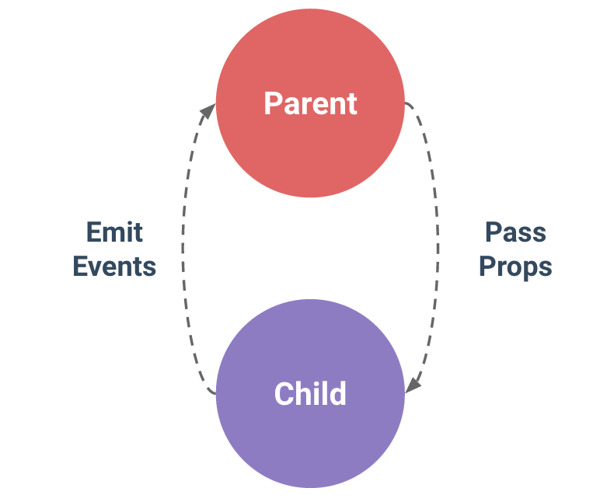
{Vue Components - Demo}
Powerful way to facilitate code reuse
Vue components are also Vue instances
Can register both globally and locally
The data object must be a function
Components can be composed
Components data is isolated from each other
Can communicate through well defined interfaces:
Props down
Events up
Notes:
Components are one of the most powerful features of Vue. They help you extend basic HTML elements to encapsulate reusable code. At a high level, components are custom elements that Vue’s compiler attaches behavior to.
All Vue components are also Vue instances, and so accept the same options object (except for a few root-specific options) and provide the same lifecycle hooks.
To register a global component, you can use Vue.component(tagName, options). You can also do this locally using the components instance option

Slide 26
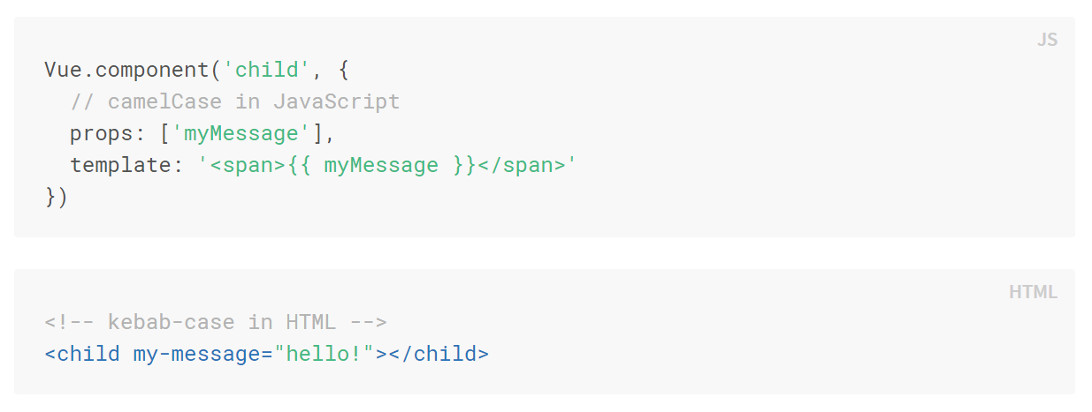
{Vue Props – Demo}
Used to pass data to children
Meant to be one-way although two-way is supported with .sync
Props can be set with local values or bound
Props can be validated
Camel vs Kebab casing

Slide 27
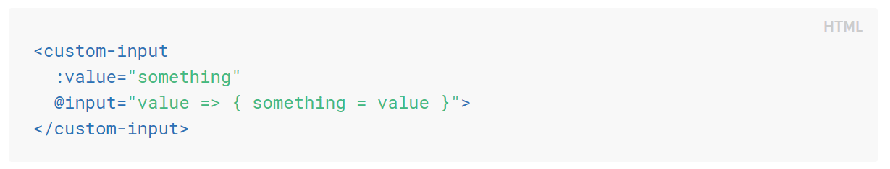
{Vue Custom Events – Demo}
Used to pass data to the parent
Listened for by with the v-on directive
Emitted using the $emit(‘eventName’, [param]) method
Events and Props can be used to support v-model

Slide 28

{Vue Lifecycle}
https://vuejs.org/v2/guide/instance.html#Lifecycle-Diagram
Notes:
Below is a diagram for the instance lifecycle. You don’t need to fully understand everything going on right now, but as you learn and build more, it will be a useful reference.
It is a very good place to go and check if you are stuck.

Slide 29

{Kendo UI for Vue}
Based on Kendo UI for jQuery
Implemented as Vue wrappers on top of the jQuery components
There are KendoUI wrappers for:
Angular.js
React
Server-side frameworks
Notes:
Can actually access the underlying kendo widget using .kendoWidget()
Implemented as plugins <Widget>Installer which do the heavy lifting

Slide 30

Data Source
Validation
Globalization
Templates
Drag & Drop
MVVM
Export
Components

Slide 31
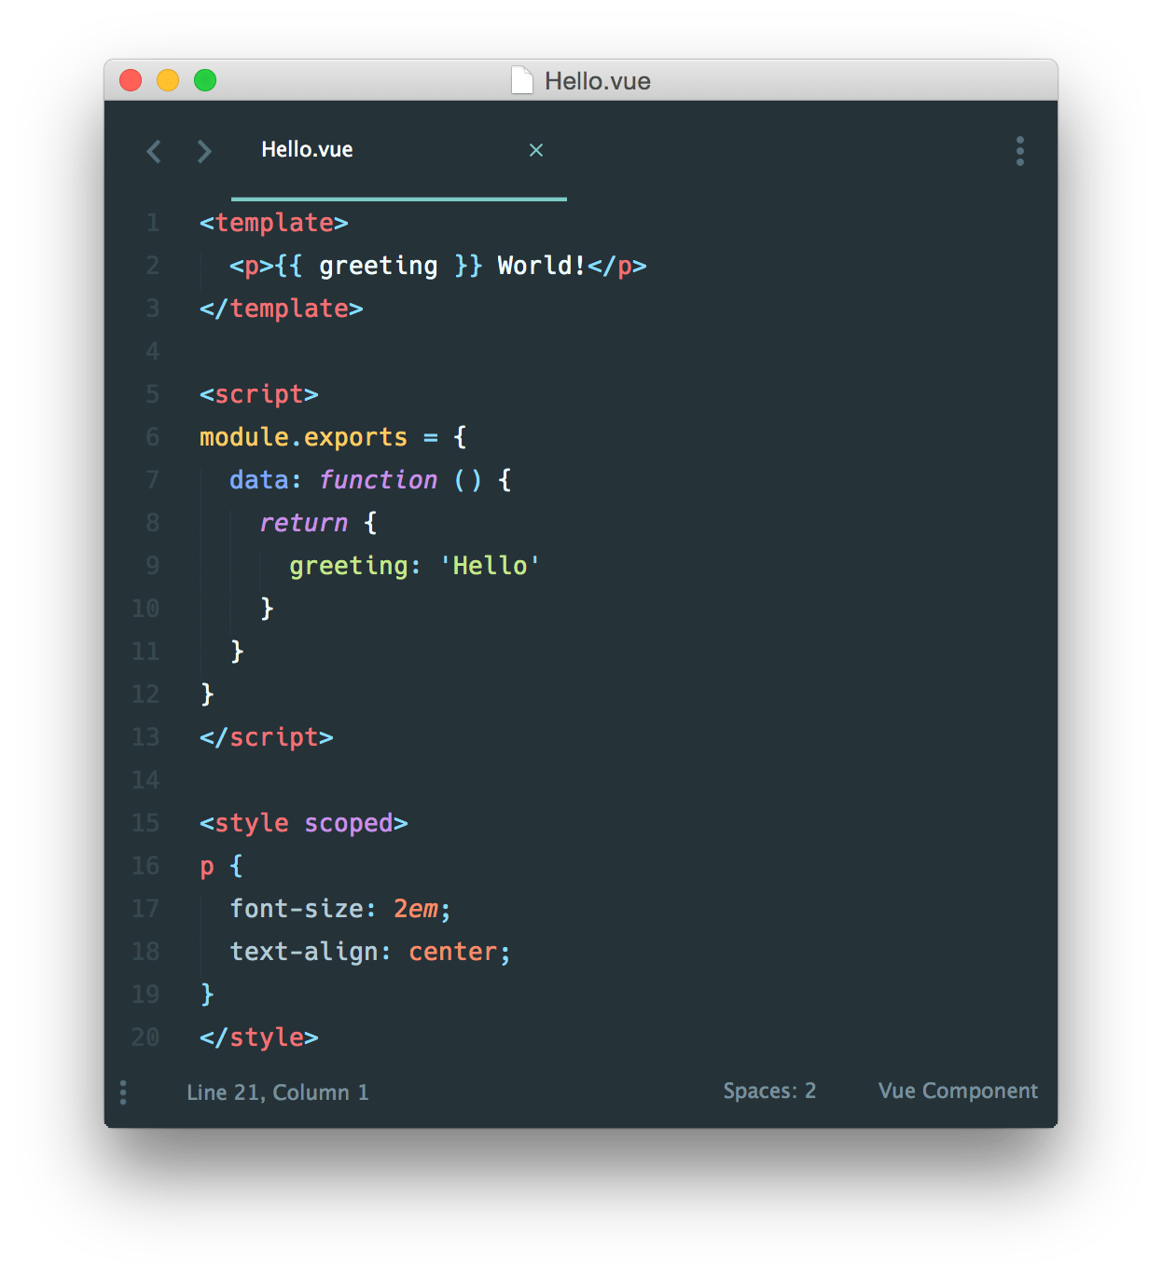
{Building real-world apps with Vue}
Vue is simply a library that facilitates MVVM
There are many other pieces in the Vue ecosystem
VueRouter provides routing capabilities
VueEx provides state management services
Single file components with Webpack
Setting up a project is convoluted
Vue CLI to the rescue!
npm install -g @vue/cli

Slide 32
{Short Break}
Please take ~10 minutes to relax and recharge

Slide 33

{Live Code Demo}
We will build a real-world dashboard app together with the Vue CLI!

Slide 34

{Theme Builder}
URL: http://themebuilder.telerik.com/kendo-ui

Slide 35

{Resources}
Vue.js Documentation:
https://vuejs.org/v2/guide/
Vue.js API Reference
https://vuejs.org/v2/api/
Kendo UI for Vue Demos:
https://www.telerik.com/kendo-vue-ui/components/
Kendo UI Blog:
https://www.telerik.com/blogs/kendo-ui
New Venture Software’s Blog:
https://www.newventuresoftware.com/blog

Slide 36
{The End}
Thank you for attending the Progress Virtual Classroom!
This concludes today’s training. Feel free to submit any remaining questions and we will do our best to reach out to everyone.

